Slide 1
AIR CONDITIONING · CHAPTER 1
1.5 Refrigerants
1
2
Types, properties, environmental impact, and regulation
1.5
Refrigerant choice is both a thermodynamic and environmental design decision.
ODP
GWP
3
4
Safety
Regulation
Concept-first slides with teaching detail in the card
Air Conditioning · Chapter 1 · Topic 1.5
1

Slide 2
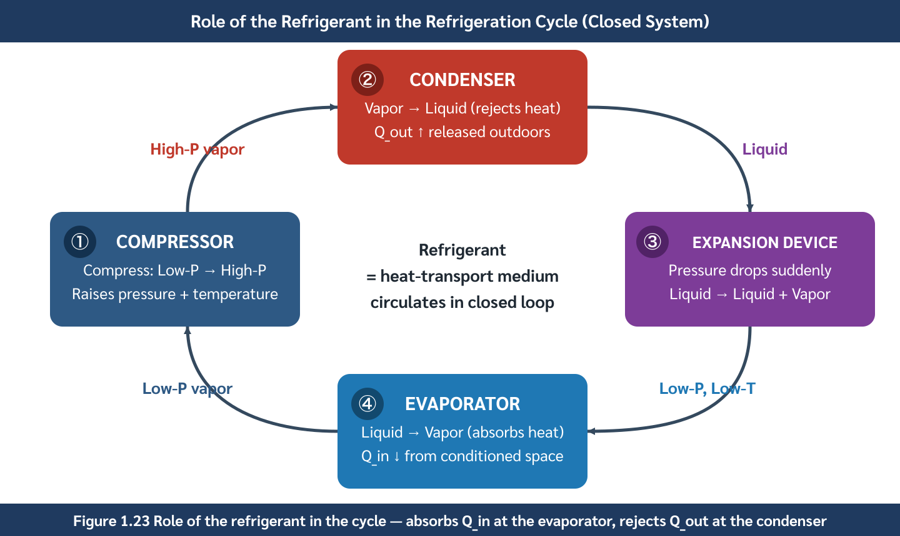
The refrigerant is the heat-transfer working fluid
2
It absorbs heat indoors and rejects heat outdoors.
CYCLE ROLE
The working fluid carries energy around the loop
High latent heat
1
more cooling per kg
Practical pressure
2
safe pipe and equipment pressure
Compatibility
3
piping, seals, and compressor oil
Refrigerant role in the vapor compression cycle
Air Conditioning · Chapter 1 · Topic 1.5
2

Slide 3
A good refrigerant is a compromise
3
No refrigerant is perfect in every category
Thermodynamic
Safety
Materials
1
2
3
high latent heat and good pressure curve
low toxicity and flammability for occupied spaces
does not corrode or degrade oil/seals
Environment
Serviceability
4
5
zero ODP and low GWP
available tools, cylinders, and technician skill
Air Conditioning · Chapter 1 · Topic 1.5
3

Slide 4
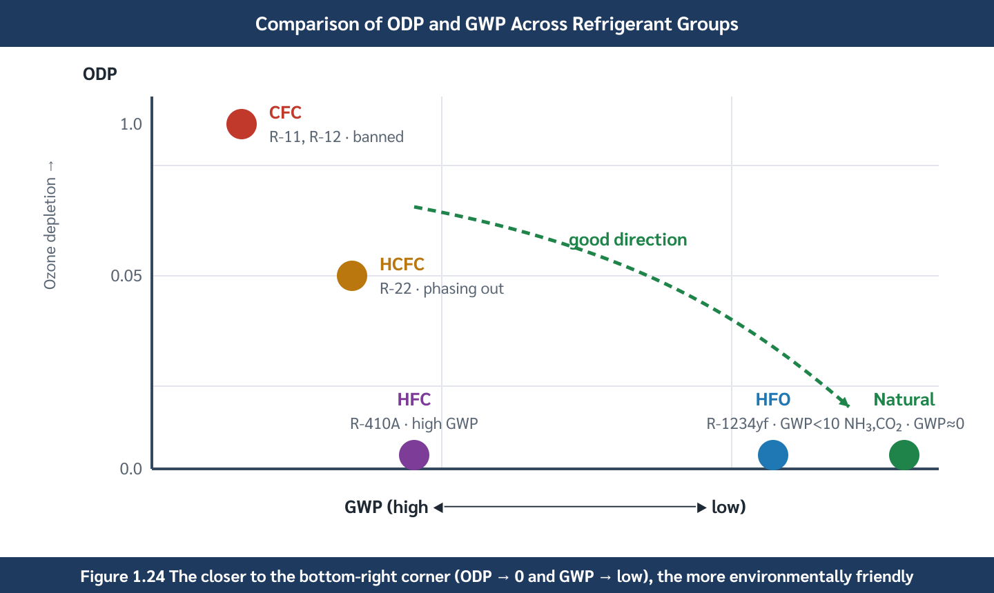
ODP and GWP are different environmental risks
4
Zero ozone depletion does not guarantee low climate impact.
INDICES
ODP protects ozone; GWP protects climate
ODP
1
referenced to R-11 = 1.0
GWP
2
referenced to CO₂ = 1
Modern target
3
ODP = 0 and low GWP
ODP and GWP comparison
Air Conditioning · Chapter 1 · Topic 1.5
4

Slide 5
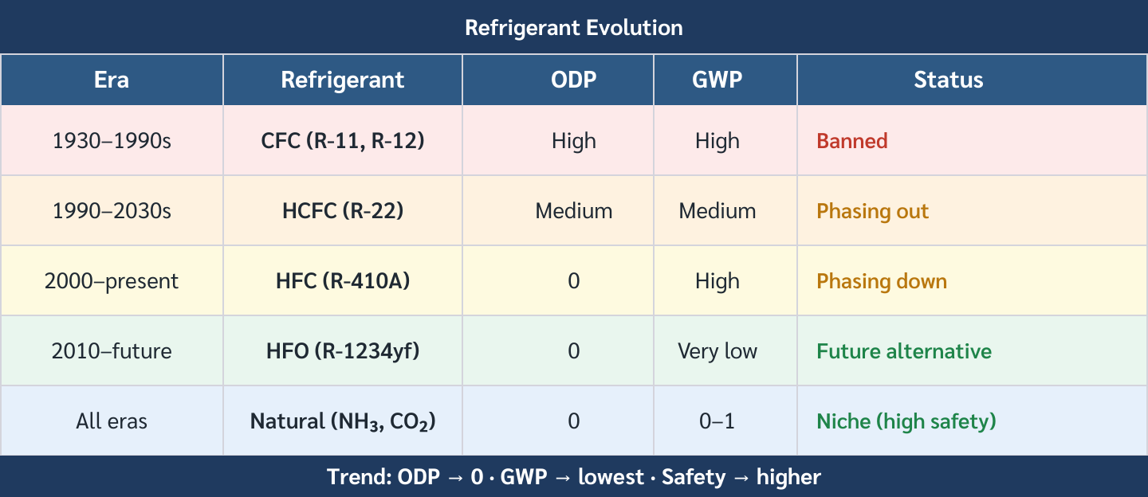
Refrigerant families changed because rules changed
5
Environmental regulation reshaped HVAC equipment.
EVOLUTION
CFC → HCFC → HFC → HFO/natural
CFC
1
high ODP; banned legacy
HCFC
2
lower ODP; phase-out
HFC
3
zero ODP but high GWP
Historical evolution of refrigerant families
Air Conditioning · Chapter 1 · Topic 1.5
5

Slide 6
Common families: what students should say aloud
6
Turn the table into engineering judgement
CFC
HCFC
HFC
1
2
3
legacy only; severe ozone issue
R-22 style transition refrigerant; phase-out risk
common today but climate phase-down pressure
HFO
Natural
4
5
low GWP; often A2L and higher cost
very low GWP; toxicity/pressure/flammability constraints
Air Conditioning · Chapter 1 · Topic 1.5
6

Slide 7
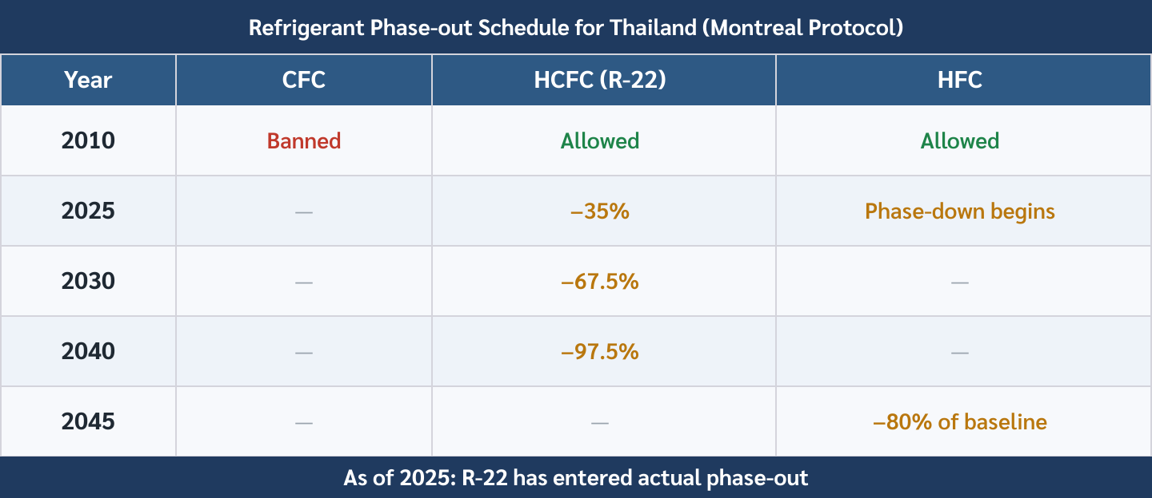
Thailand must design for phase-out and phase-down
7
Equipment life is longer than many refrigerant policy milestones.
REGULATION
Specify for the future, not only today
HCFC phase-out
1
near-complete by 2040
HFC phase-down
2
started 2024; target reduction by 2045
Design implication
3
future availability and price risk
Thailand refrigerant regulation timeline
Air Conditioning · Chapter 1 · Topic 1.5
7

Slide 8
Safety class affects room and service design
8
Low-GWP choices may introduce mild flammability or pressure issues
A1
A2L
A3
1
2
3
lower toxicity, no flame propagation
mildly flammable; check charge and ventilation
flammable; usually small sealed systems
CO₂
Ammonia
4
5
very high pressure; special equipment
excellent performance but toxic; industrial controls
Air Conditioning · Chapter 1 · Topic 1.5
8

Slide 9
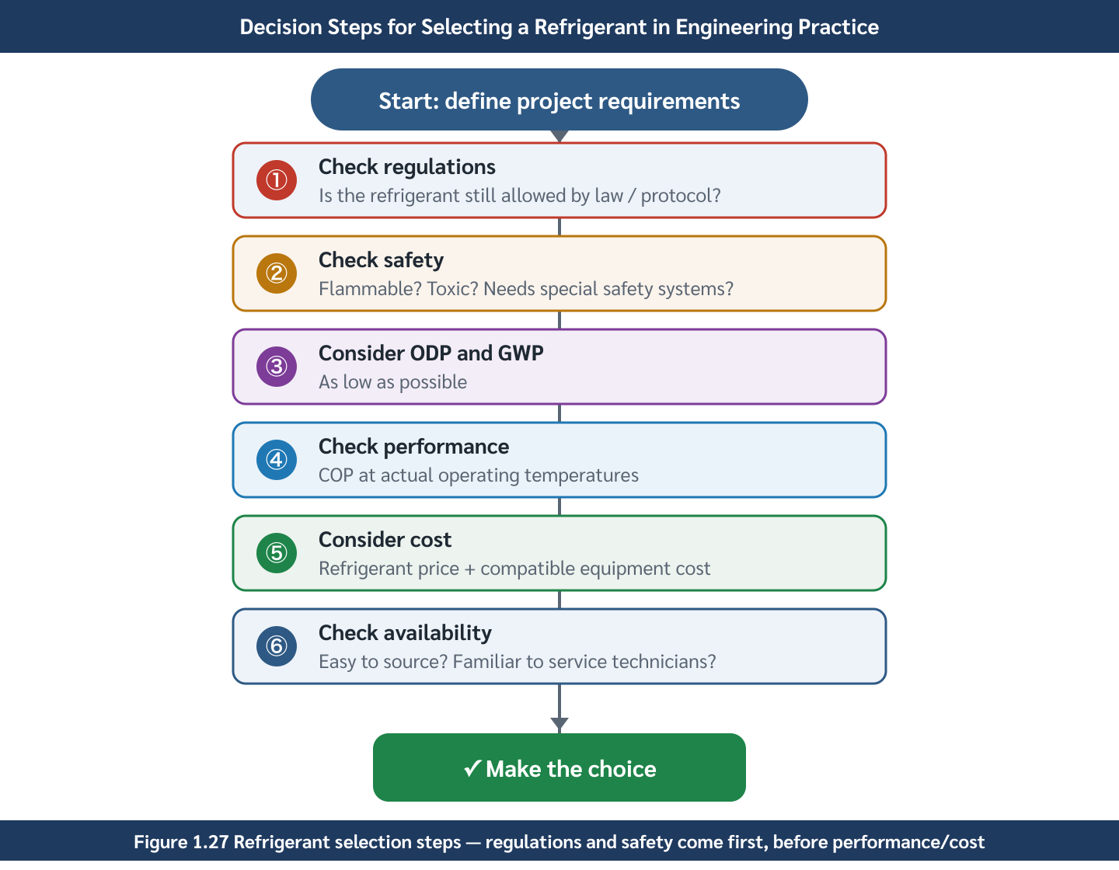
Refrigerant selection is a multi-criteria decision
9
Do not choose only by COP or only by GWP.
SELECTION LOGIC
Balance performance, safety, environment, and service
Efficiency
1
cycle performance and pressure levels
Safety
2
toxicity, flammability, charge limits
Regulation
3
future availability and compliance
Refrigerant selection factors
Air Conditioning · Chapter 1 · Topic 1.5
9

Slide 10
Pause question: R-410A or R-32 for a new split AC?
10
Use this to make students compare more than one criterion
R-410A
R-32
Safety
1
2
3
widely used; high GWP ≈ 2088
lower GWP ≈ 675
R-32 is A2L mildly flammable
Answer
4
prefer lower GWP when approved equipment and service support exist
Air Conditioning · Chapter 1 · Topic 1.5
10

Slide 11
Topic 1.5 — what students should remember
11
1
2
3
Refrigerants affect many risks
ODP and GWP are separate
Specification is long-term
efficiency, safety, service, environment, and regulation
zero ODP is not enough if GWP remains high
choose for service life and regulatory trajectory
Air Conditioning · Chapter 1 · Topic 1.5
11

